Slide 1
Company products Manager

Slide 2
By…
1. Ahmed Abdelsalam Elgamal
2. Ahmed Said Salem
3. Ahmed Adel Wahsh
4. Mohamed Said Galhoum

Slide 3
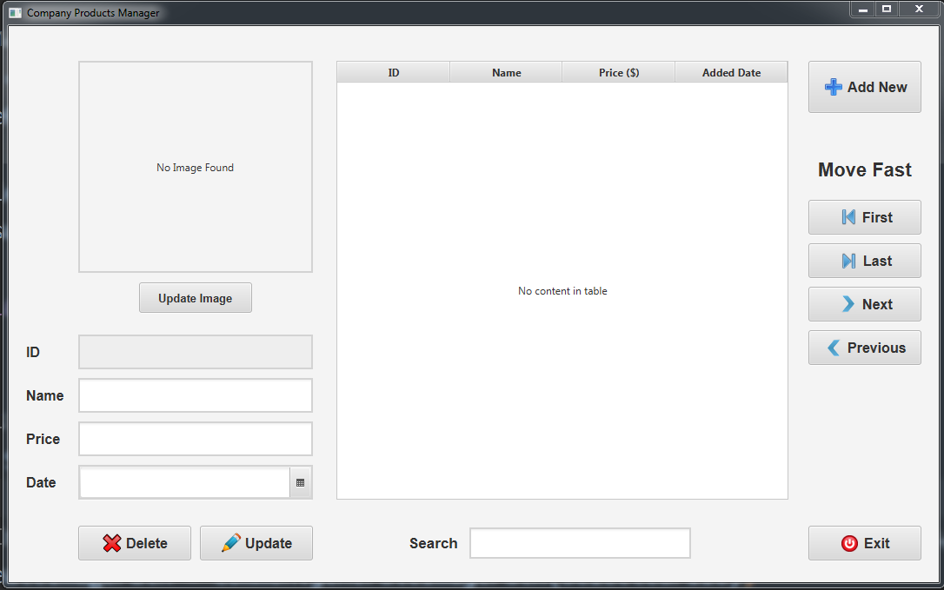
This is the main program interface without adding any elements yet

Slide 4
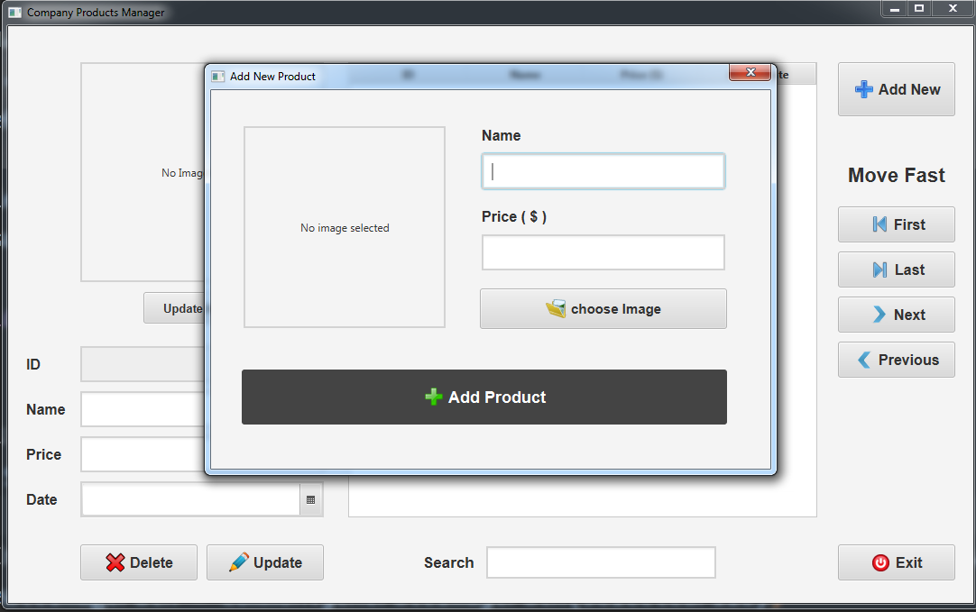
When we click “Add New” button this layout will appear to let you insert product info

Slide 5
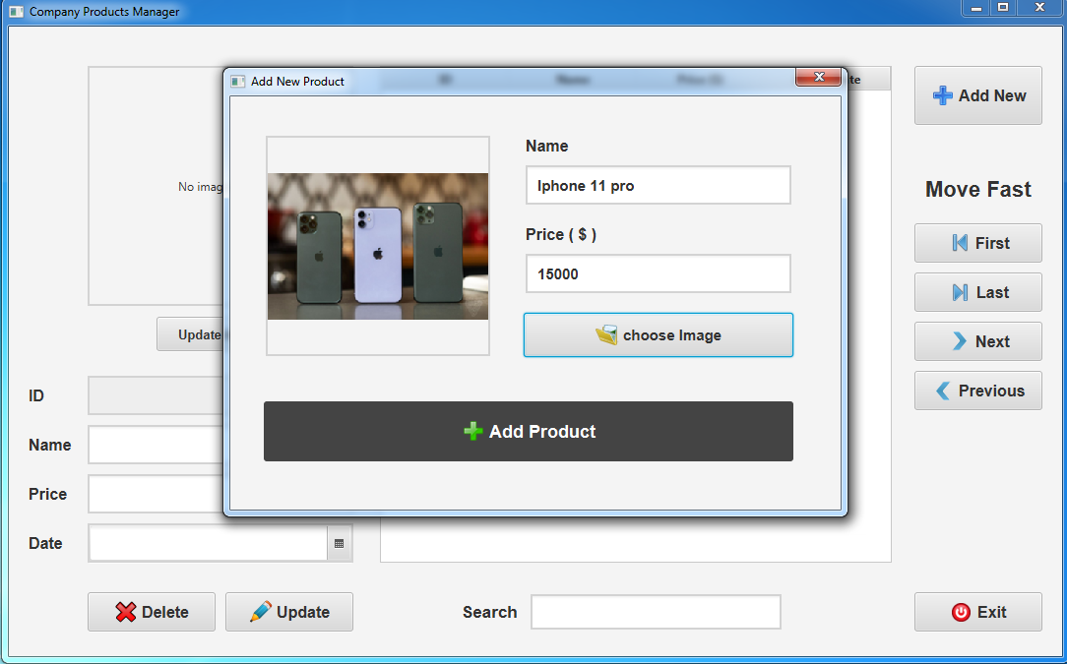
We will add many products like that

Slide 6
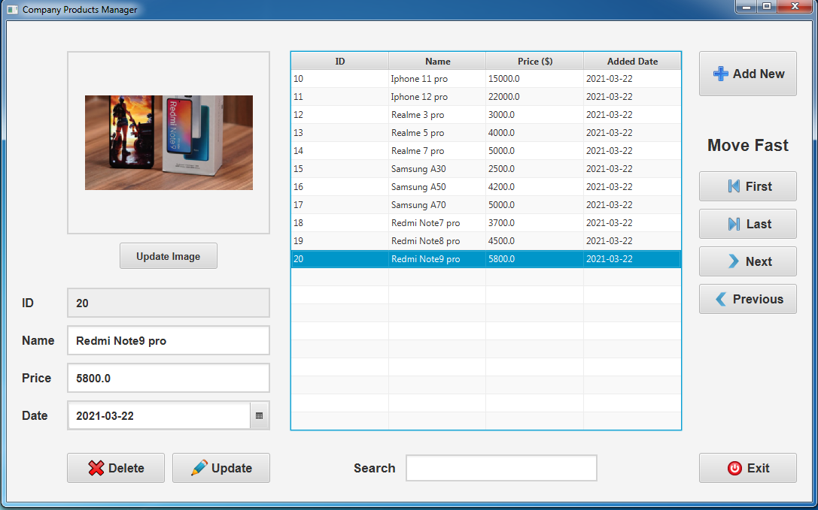
It will appear in this way

Slide 7
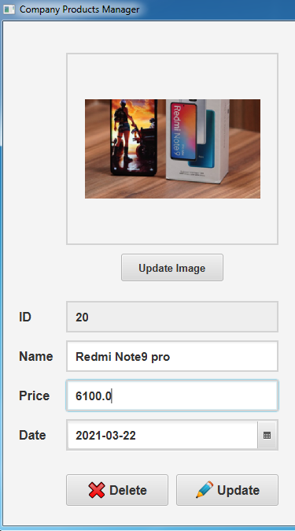
Left side shows the information about the selected product and lets us update or delete it

Slide 8
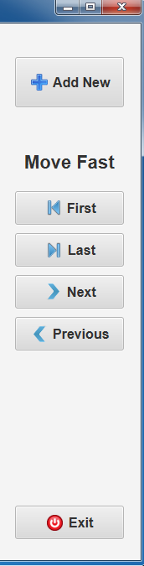
Right side lets us add new products or exit, And it contains some buttons to facilitate moving from an item to another

Slide 9
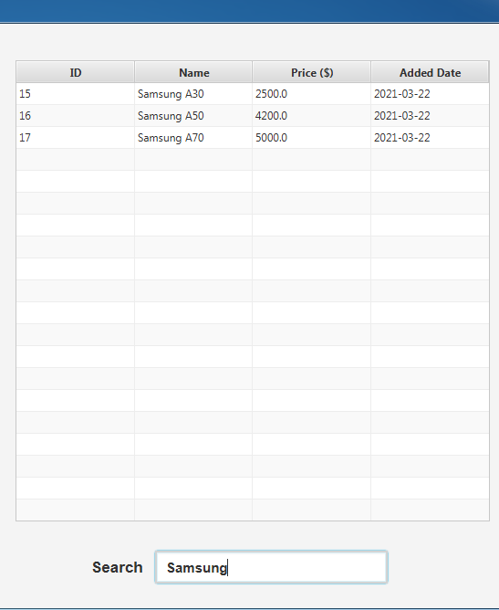
In the center of page, there is a list of products and a search input to let you search for needed items

Slide 10
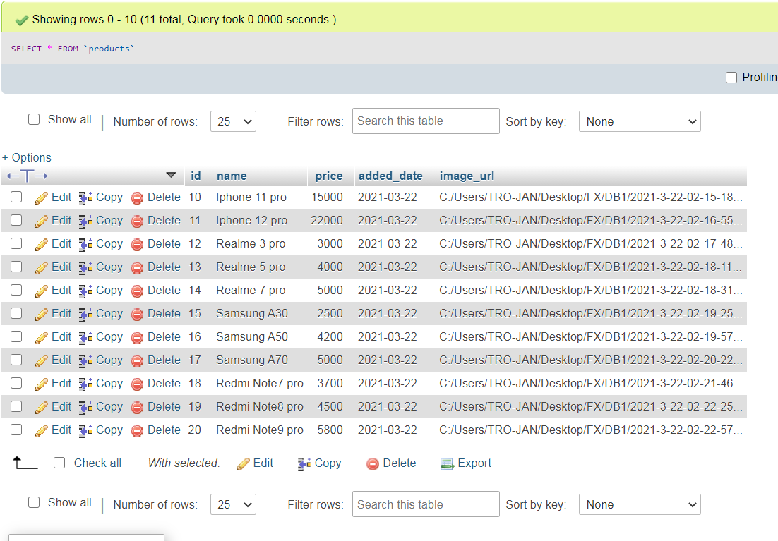
Here is a look of our database that contains 5 columns (id, name, price, added_date, image_url)

Slide 11
Thank You

